Slide 1
Antiderivatives Session 11
Course : MATH 6031 – Calculus
Year : 2021

Slide 2

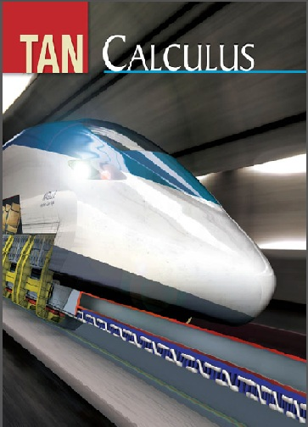
These slides have been adapted from: Dale Varberg, Edwin Purcell, Steve Rigdon. 2007. Calculus. Prentice Hall. ISBN: 978-0132306331. Soo.T.Tan. Calculus. 2010. Brooks/Cole. ISBN-13: 978-0-534-46579-7
Acknowledgement

Slide 3

Learning Objectives
LO 3:
Explain the properties of integral to describe geometric and physical problems, and other applications.

Slide 4
Content
1
Definition and Example
2
Rules for Antiderivatives
3
Linearity The Indefinite Integral

Slide 5
Antiderivatives
Definition
We call F an antiderivative of f on the interval I if $D_{x}F\left(x\right)=f(x)$ on I, that is, if $F^{′}\left(x\right)=f(x)$for all x in I.
Definition
We call F an antiderivative of f on the interval I if 𝐷_𝑥 𝐹(𝑥)=𝑓(𝑥) on I, that is, if 𝐹^′ (𝑥)=𝑓(𝑥)for all x in I.
Example:
We seek a function F satisfying $F^{′}\left(x\right)=$for all real x. From our experience with differentiation, we know that is one such Function.
Is every antiderivative of $f\left(x\right)=4x^{3}$of the form $F\left(x\right)=x^{4}$?
The answer is yes.
Example:
We seek a function F satisfying 𝐹^′ (𝑥)=for all real x. From our experience with differentiation, we know that is one such Function.
Is every antiderivative of f(x)=4𝑥^3of the form 𝐹(𝑥)=𝑥^4?
The answer is yes.

Slide 6
Notation for Antiderivatives
Antiderivative
The process of finding all antiderivatives of a function is called antidifferentiation or integration.
Notation
The integral operator is denoted by the integral sign ∫, and the process of integration is indicated by the expression
$$\int{f\left(x\right)dx}=F\left(x\right)+C$$
The integral operator is denoted by the integral sign ∫, and the process of integration is indicated by the expression
∫▒𝑓(𝑥)𝑑𝑥=𝐹(𝑥)+𝐶
Read
Read “the indefinite integral of f(x) with respect to x equals F(x) plus C.”

Slide 7
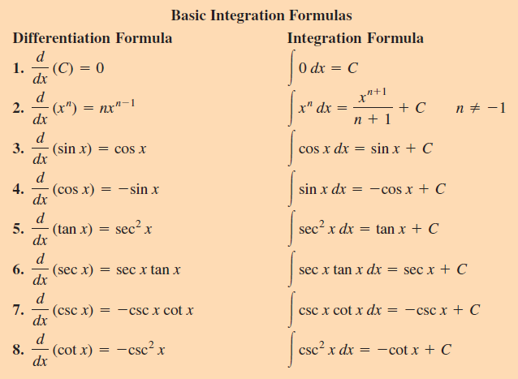
Some Basic Integration

Slide 8
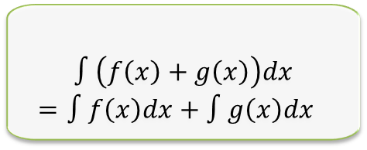
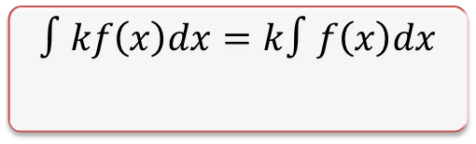

Linearity The Indefinite Integral
Let f and g have antiderivatives (indefinite integrals) and let k be a constant. Then
2
$$∫\left(f\left(x\right)+g\left(x\right)\right)dx$$
$$=∫f\left(x\right)dx+∫g\left(x\right)dx$$
$$∫\left(f\left(x\right)−g\left(x\right)\right)dx$$
$$=∫f\left(x\right)dx−∫g\left(x\right)dx$$
$$∫kf\left(x\right)dx=k∫f\left(x\right)dx$$
3
1

Slide 9

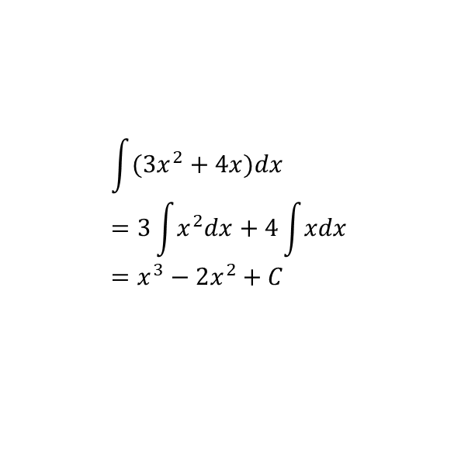
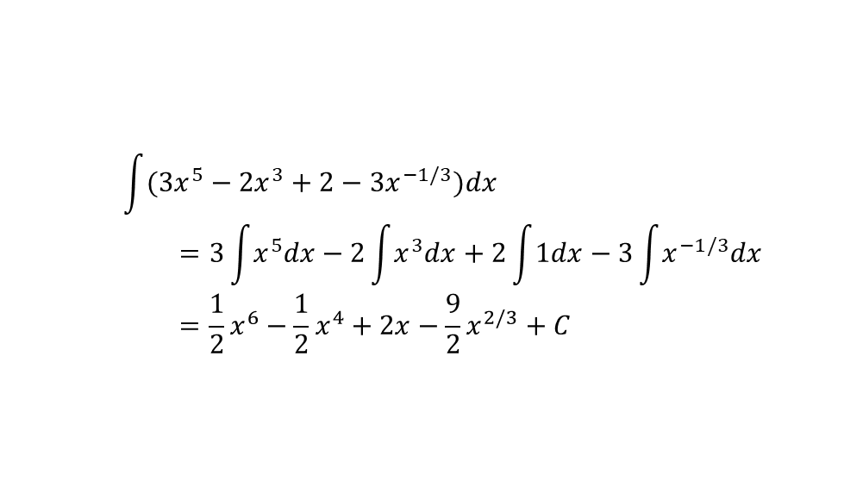
Example
Example 1
Example 2
Example 3
$$\int{(3x^{2}+4x)dx}$$
$$=3\int{x^{2}dx}+4\int{xdx} \\ =x^{3}−2x^{2}+C$$
$$\int{\left(\frac{1}{t^{2}}+\sqrt{t}\right)dt}$$
$$=\int{t^{−2}dt}+\int{t^{\frac{1}{2}}dt}$$
$$={−x}^{−1}+\frac{2}{3}x^{\frac{3}{2}}+C$$
$$\int{(3x^{5}−2x^{3}+2−3x^{−1/3})dx}$$
$$=3\int{x^{5}dx}−2\int{x^{3}dx}+2\int{1dx}−3\int{x^{−1/3}dx} \\ =\frac{1}{2}x^{6}−\frac{1}{2}x^{4}+2x−\frac{9}{2}x^{2/3}+C$$

Slide 10
Dale Varberg, Edwin Purcell, Steve Rigdon. 2007. Calculus. Prentice Hall. ISBN: 978-0132306331.
Dale Varberg, Edwin Purcell, Steve Rigdon. 2014. Calculus Early Transcendentals. Pearson New International Edition. ISBN: 978-1-292-04268-8
Soo.T.Tan. 2010. Calculus. Brooks/Cole. ISBN-13: 978-0-534-46579-7

